Slide 1
HOTEL MANAGEMENT SYSTEM
Submitted by: Mehrab Zaman (134404)
Hasibul Kabir (134409)
Anower Jahan (134412)

Slide 2
Current Problem(s)
Site Name:
Agoda.com
Problem(s):
All currencies available around the hotel are not shown.

Slide 3
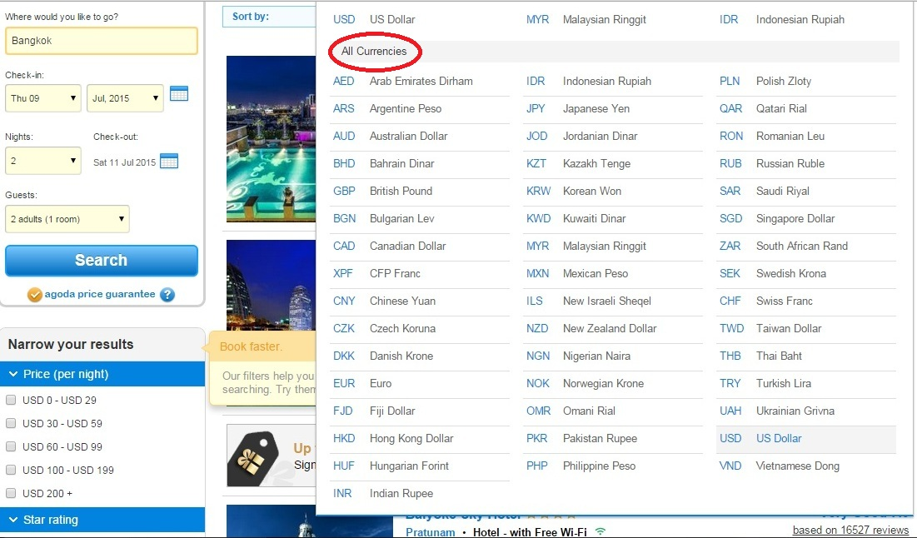
Screenshot of problem

Slide 4
Proposed Solution(s)
Ensuring all the currencies are available in the site
If ensuring all currencies are not available then at least the site should have the conversion information from major currency to local currency.

Slide 5
Current Problem(s)
Site Name:
bdhotels.travel
Problem(s):
There are no information about current rate of other currencies in BDT.
Not clear which day’s BDT currency rate will be considered as booking fee.

Slide 6
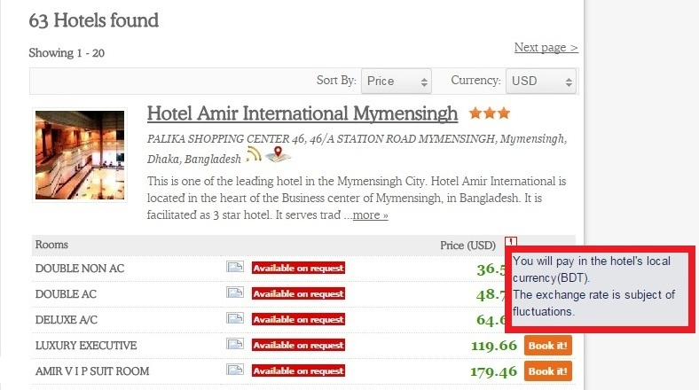
Screenshot of problem

Slide 7
Proposed Solution(s)
Clear instructions about transaction money will be provided.
Present rate of other currencies in BDT have to be provided and updated daily.
There can be converter for BDT rate.

Slide 8
Current Problem
Site Name: bdhotels.travel
Problem:
The site is slow for searching any hotel details.
A searching notification appears before the Site Header.

Slide 9
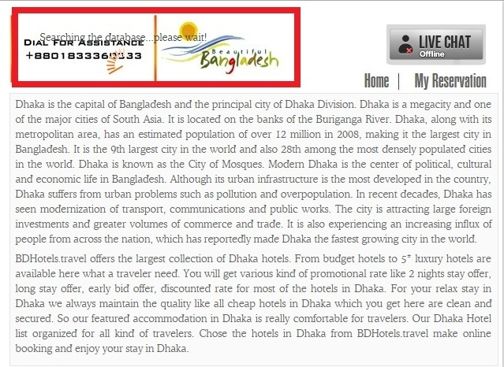
Screenshot of Problem

Slide 10
Proposed Solution(s)
An efficient algorithm will be applied for searching work.
Searching notification will not come forward or come in a suitable place.

Slide 11
Current Problem(s)
Site Name:
HotelsCombined.com
Problem(s):
Picture showing method doesn’t respond quickly and remain blank sometimes.

Slide 12
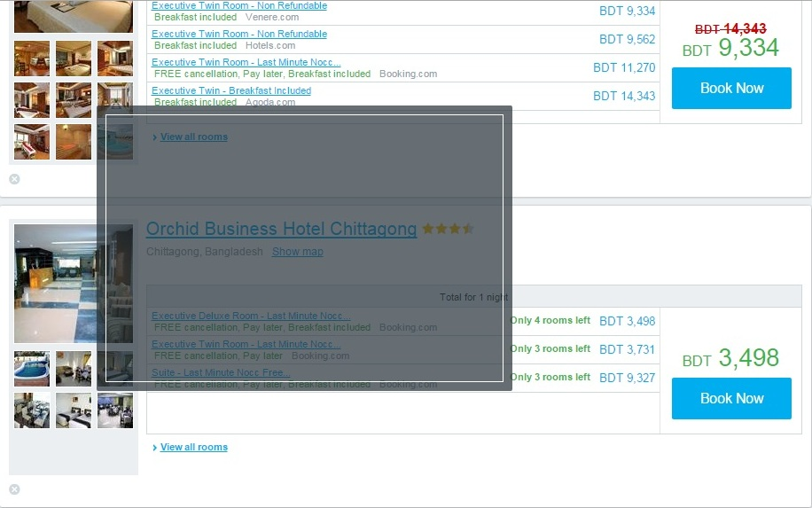
Screenshot of Problem

Slide 13
Proposed Solution
The picture showing method should be updated through an efficient way.

Slide 14
Current Problem(s)
Site Name:
HotelsCombined.com
Problem(s):
When user search the hotel by category the hotel description drops below and make a blank space on site

Slide 15
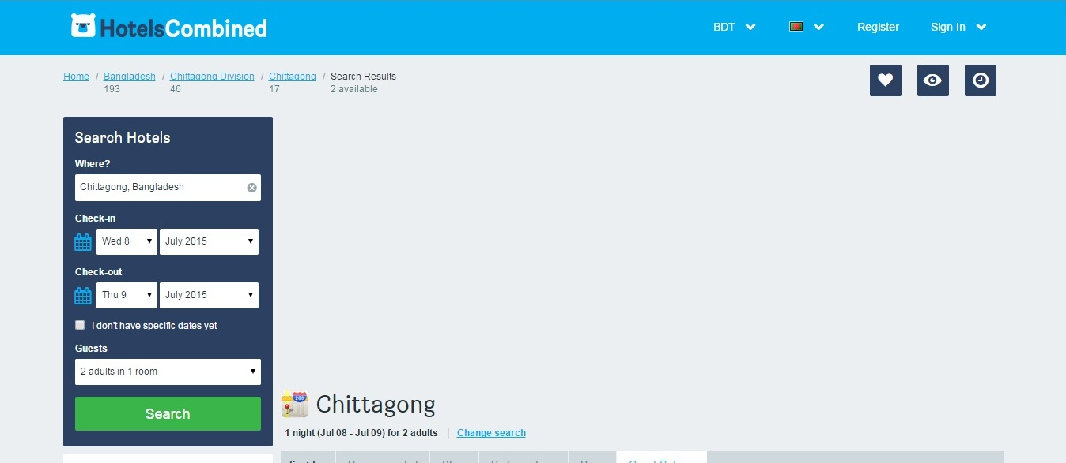
Screenshot of Problem

Slide 16
Proposed Solution(s)
Site design will be updated through changing and finding error in codes.

Slide 17
Current Problem(s)
Site Name:
HotelsCombined.com
Problem(s):
Third party assurance is not maintained

Slide 18
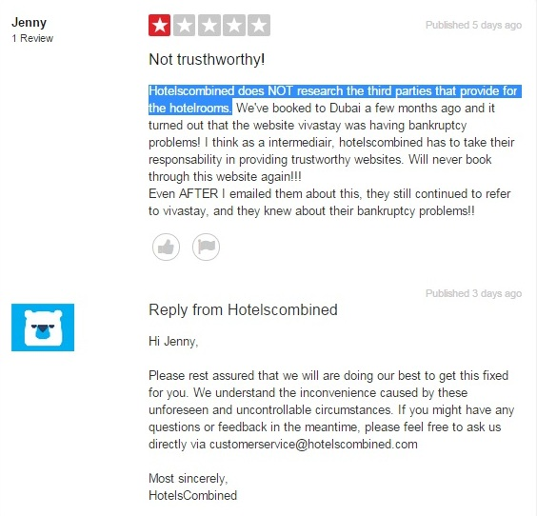
Screenshot of Problem

Slide 19
Proposed Solution(s)
Regular contact with the third party of transaction money.
Ensuring compensation to suffered customers from third parties.
Rate the third party companies according to their services.

Slide 20
Current Problem(s)
Site Name:
HotelBangladesh
Problem(s):
Major cities are not there
Poor details of hotels

Slide 21
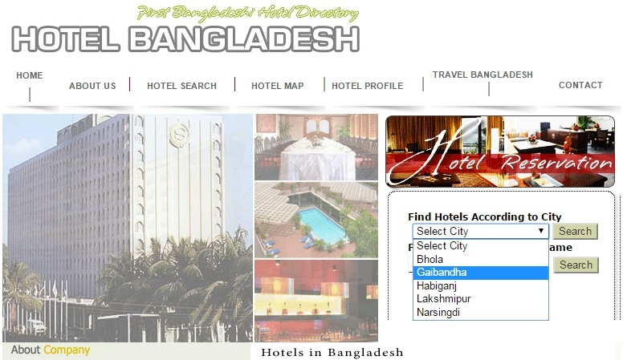
Screenshot of problem(s)

Slide 22
THANK YOU

